Slide 1
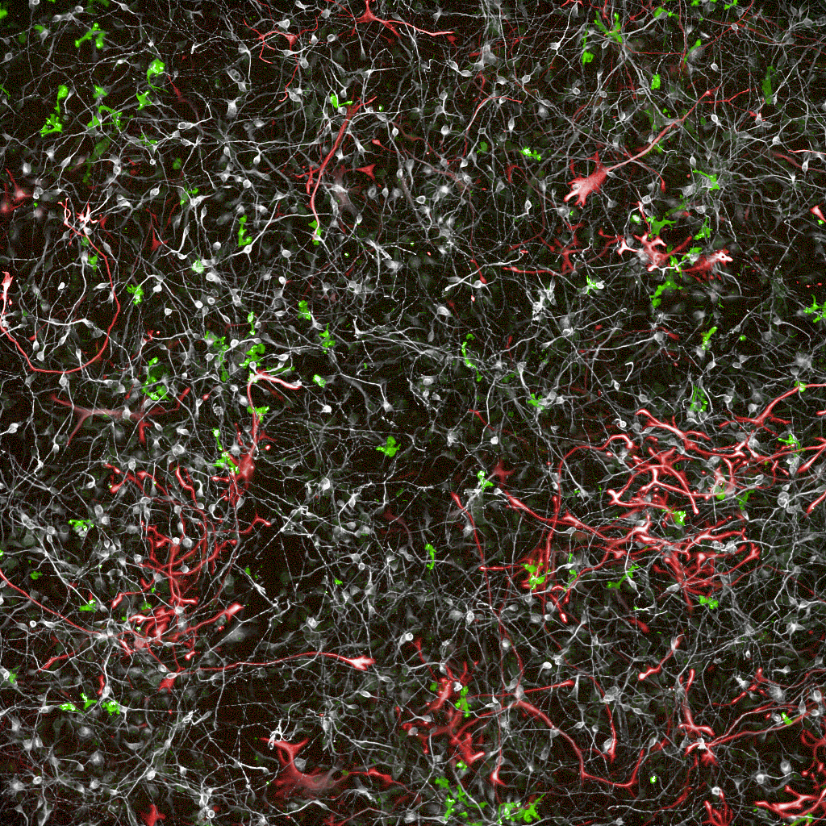
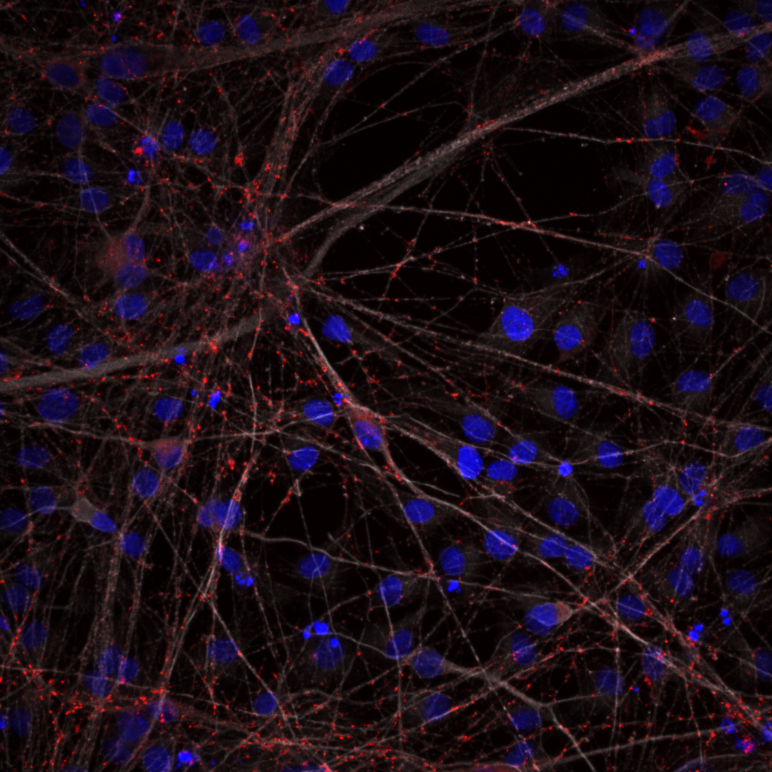
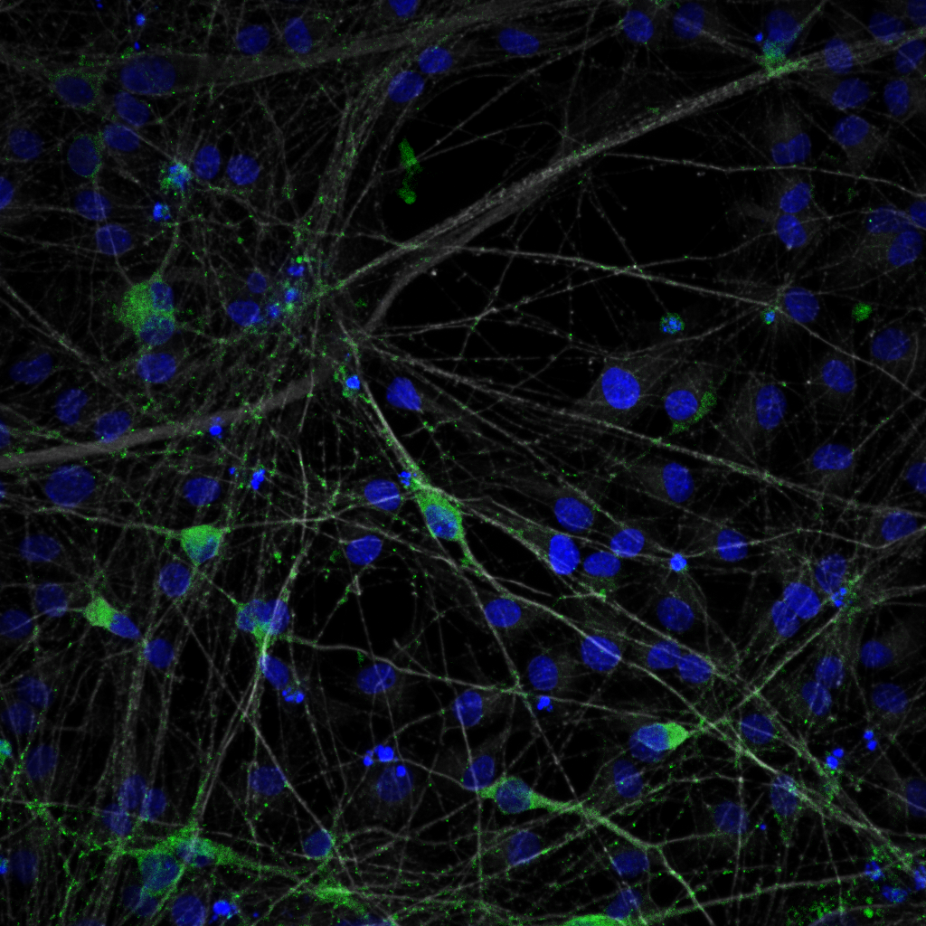
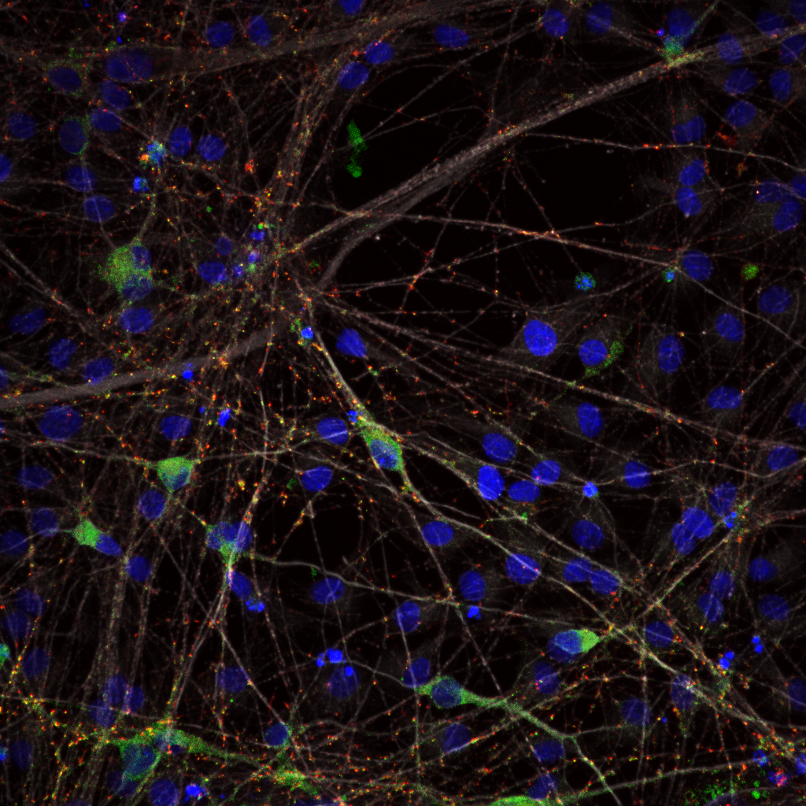
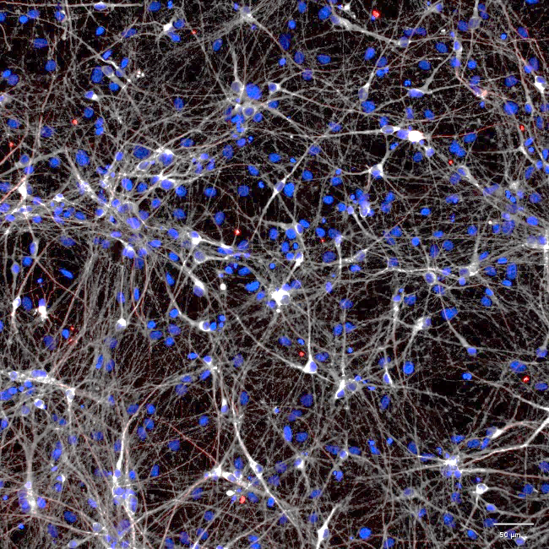
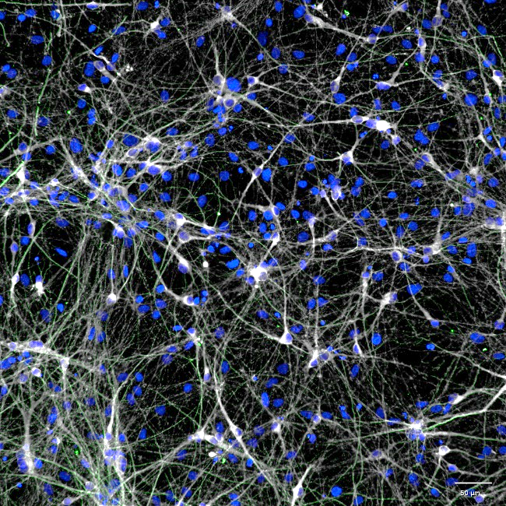
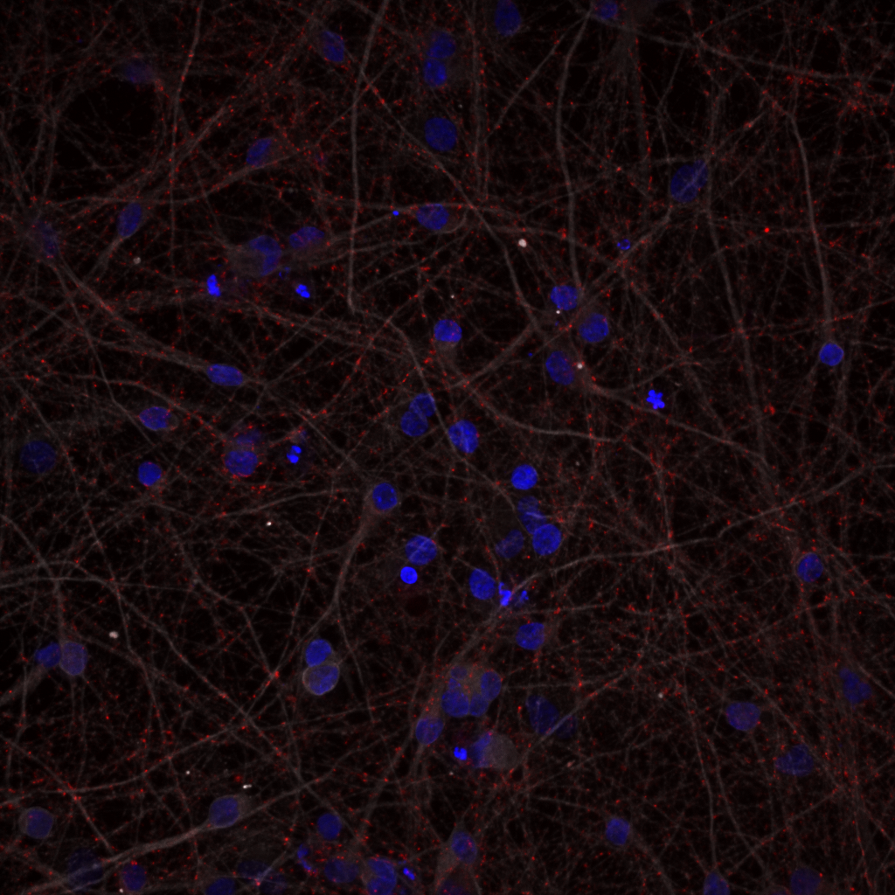
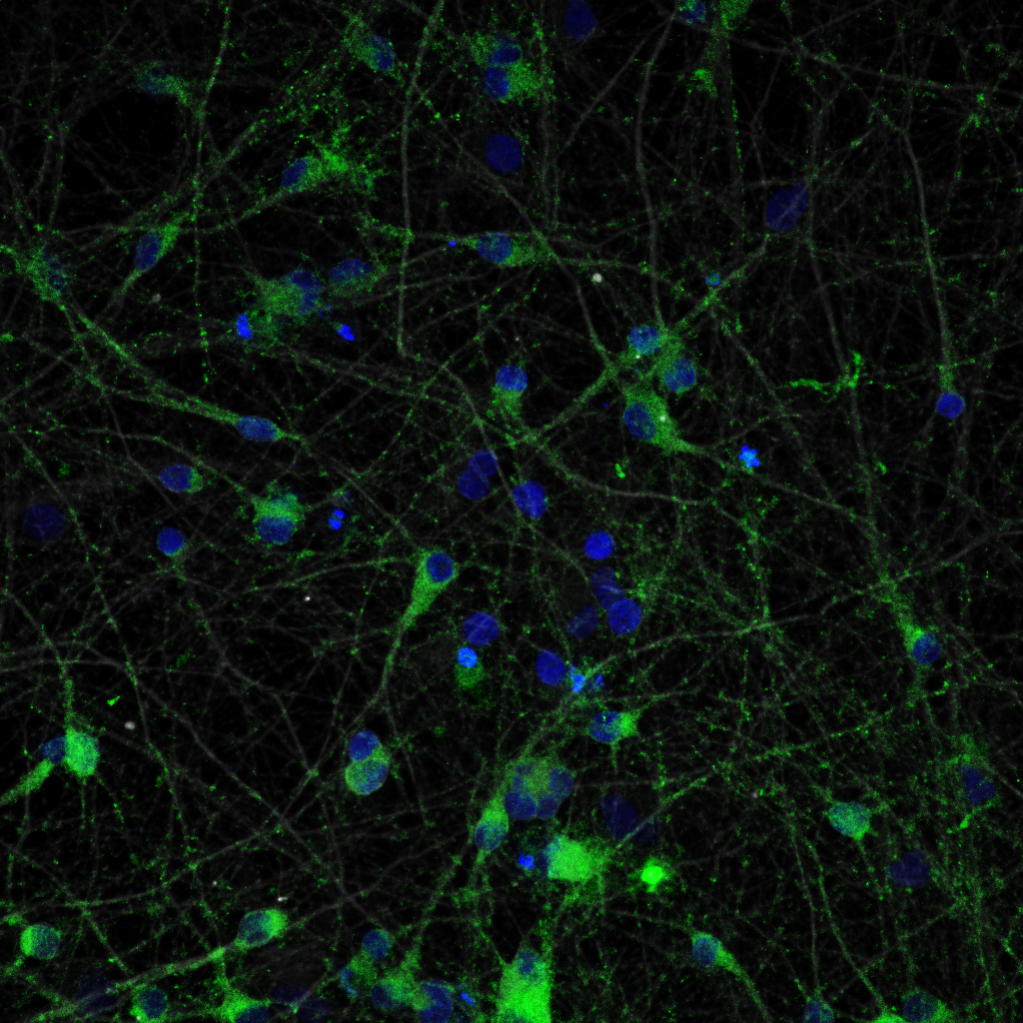
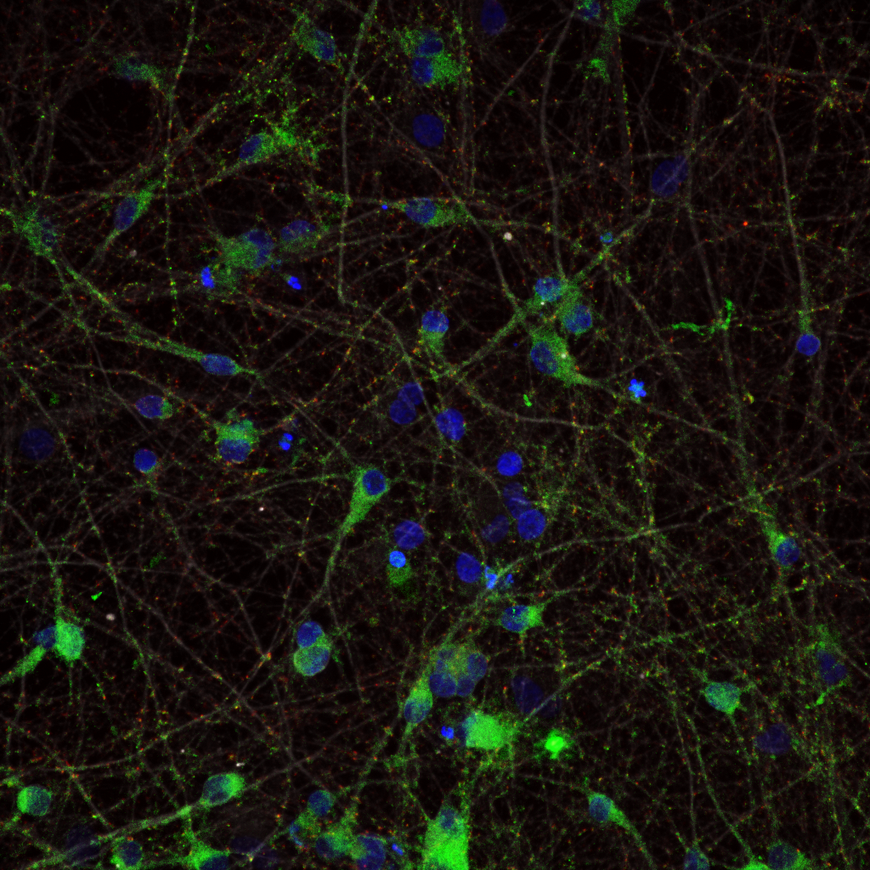
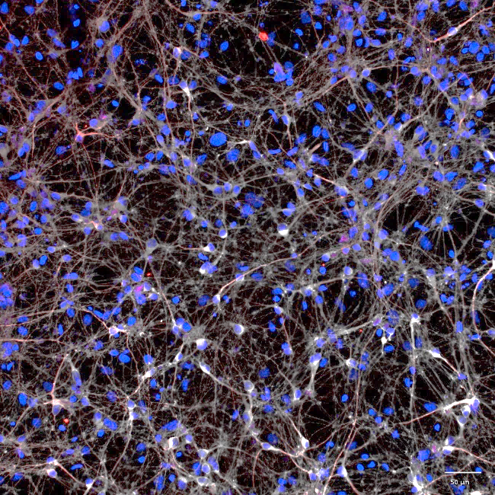
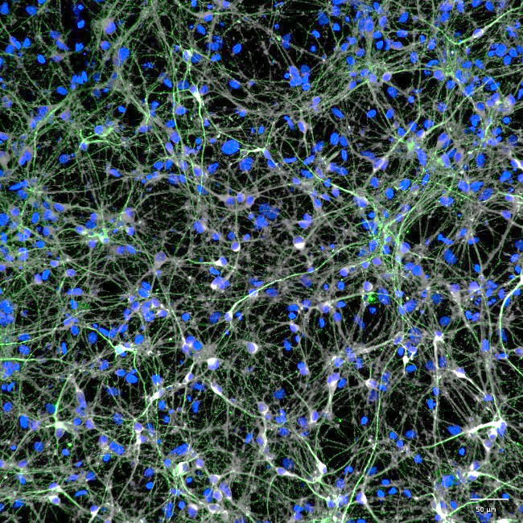
Evaluation of human induced pluripotent stem cell (hiPSC)-derived tri-culture as in vitro model for Alzheimer’s Disease
L. SMIT. VAN BERKEL, L. SMIT, J. COTOVIO, P. VAN LOENEN, M. ARGENZIANO , S. JAIN;
Ncardia Services BV Leiden, The Netherlands, support@ncardia.com, www.ncardia.com
Background
The development of physiologically relevant models for Alzheimer’s Disease (AD) remains a challenge with an unfilled gap in translatable human-based platforms. Ncardia developed human tri-culture models composed of neurons, astrocytes and microglia derived from iPSCs, resembling physiological conditions that allow modulation of neuroinflammation and neurodegeneration in vitro in the context of AD.
Firstly, we identified relevant triggers as TAU species capable of inducing cellular responses specific to AD pathology in cultures of microglia.
Secondly, we established a tauopathy model in the tri-culture system, by inducing the phosphorylation (pTAU), misfolding and aggregation of TAU, using different recombinant mutant TAU (pre-formed fibrils) PFFs. This approach enabled a multi-parametric readout of neuronal and glial phenotypes including activation of microglia and astrocytes in the tri-culture, and release of pro-inflammatory cytokines in the supernatants.
The development and validation of models of relevant biological disease processes, such as microglia-neuron communication, provides insight on cellular interactions. Modeling these cellular interactions play a role in recognizing apoptotic neurons and modulating neuronal activity, which are crucial events in disease progression. Targeting these pathways in human models with a combination of clinically-relevant readouts allows evaluating the ability of therapeutics on rescuing not only primary, but also secondary and tertiary neuro-pathological signatures.
1. AD related triggers in microglia monocultures
3. Establishment of CNS tri-culture system
5. Cytokine release in tri-culture system
A
IBA1 GFAP MAP2,
B
****
****
****
****
Fluorescent images from Ncyte tri-cultures stained for microglia (IBA1 in green), astrocytes (GFAP in red) and neurons (MAP2 in white). Nuclei were stained with DAPI (in grey).
Tri-culture is composed of neurons (~70%), astrocytes (~17%) and microglia (~11%)
C
A) Quantification of IL-1β, IL-6, TNF-α and IL-10 in monoculture of microglia after stimulation with different concentrations of Tau PFFs or LPS (Assay Pos Ctrl) or Cytochalasin D (Assay Neg Ctrl). Microglia is cultured in cell specific medium (white bars) or in tri-culture medium (purple bars). Median ± SD. Significance to respective vehicle control. **** p. < 0.0001
Quantification of IL-1β, IL-6, TNF-α, and IL-10 in monocultures of microglia following stimulation with increasing concentrations of TAU PFF or LPS (assay positive control). Cytokine levels were measured in the culture supernatant after 24 h using multiplex immunoassays. Data are presented as median ± SD from n = 3 biological replicates. TAU PFF stimulation induced a dose-dependent increase in pro-inflammatory cytokines (IL-1β, IL-6, TNF-α) along with elevated levels of the regulatory cytokine IL-10, indicative of an activated microglial phenotype. Significance was determined relative to respective vehicle controls (*** p < 0.001; **** p < 0.0001).
Under basal condition, Ncyte microglia do not secrete key pro-inflammatory cytokines either in mono- or tri-culture systems. Upon stimulation with LPS, Ncyte® Microglia exhibit a strong pro-inflammatory reaction both in monoculture as well as in a tri-culture system comprising of neurons, astrocytes, and microglia. LPS treatment significantly increases the production of the key inflammatory mediators IL-6, IL-10 and TNF-α in both models, as measured by Mesoscale Discovery.
2. Ncyte® Neural Mix – Mature neurons and astrocytes co-culture expressing SYN and PSD-95
4. Establishment of tauopathy model in tri-culture system
A
SYP/MAP2/DAPI
PSD95/MAP2/DAPI
SYP/PSD95/MAP2/DAPI
A
pTAU TAU
MC1 TAU
Treatment with Tau PFFs induces release of pro-inflammatory cytokines, typical of AD pathology
Maturation cocktail 1
Untransduced/vehicle
Fluorescent images of untransduced and transduced day 21 post-thaw tri-cultures stained for phospho-TAU (red), MC-1 (green), TAU (grey) and DAPI (blue). Transduced/TAU PFFs treated tricultures show increased levels of TAU, pTAU and MC-1 TAU.
Conclusions
Microglia cultures exposed to TAU PFFs species released higher levels of pro-inflammatory cytokines IL-6, IL-8, IL-1β and IL-10, an AD-related biomarker.
We observe increased levels of pTAU and MC-1⁺ TAU in a mature tri-culture, as evident from the co-localisation of pre and post synaptic markers.
Microglia in a tri-culture system demonstrate a significantly different activation profile compared to microglia in mono-culture indicating the need to include more complex models into your drug discovery project
Co-culturing neurons, astrocytes, and microglia enhances the detection of Tau-induced neurodegenerative phenotypes, offering a more physiologically relevant platform for assessing therapeutic efficacy.
A
Day 10
Day 14
Day 21
100 µm
100 µm
Medium refresh
Data analysis
Maturation cocktail 2
Transduced/TAU PFFs
Seed Ncyte Neuronal MIx
Treat with Assay Controls or Test compounds
ICC / Confocal imaging
High-content based Image Analysis using Ncardia’s in-house developed algorithms
MSD assay
B
Representative ICC images of Ncyte Neuronal Mix treated with two maturation mixes. Staining for nuclei (DAPI), pre and post synaptic markers (SYP, PSD95).
Quantification of synaptic density normalized on UTC of Ncyte Neuronal Mix treated with two maturation mixes at different concentrations.
B
Treat cells with PFF to generate disease model
Seed Microglia (monoculture and tri-culture)
MSD data analysis
High content-based quantification of the normalized parameters (pTAU puncta counts) of transduced tricultures (in black) compared to transduced tricultures treated with TAU PFFs.
Schematic of the AD model using iPSCs derived neurons, astrocytes and microglia treated with TAU PFFs. Day 10 post thaw co-cultures expressing 4R TAU P301L were treated with TAU PFFs. On day 18, Ncyte microglia were added. Co-culture of neurons, astrocytes and microglia was kept for 21 days for endpoint analysis of pTAU, MC-1 positive TAU in neurons (by ICC-IF).
Ncardia developed a neuronal and tri-culture model for Alzheimer’s Disease suitable for screening of therapeutics
Evaluate the efficacy of your therapeutic candidates in mitigating neuroinflammation and protein aggregation using Ncardia’s human in vitro tri-culture model.
Contact us at support@ncardia.com or scan the QR code to download the poster
Notes:
Figure 2: Maturation of iPSC-derived Neuronal Mix
Plate ID on SiMA: R3030-03->EXP03-P02-B4-wk5-40x_22354
Folder in Box: https://ncardia.app.box.com/folder/271386571039
Wells/fields (condition)
AraC + GENtoniK 0,3 µM- well I7 field 3
AraC/DAPT + GENtoniK 0,1 µM- well K10 field 1
Channels
FITC- PSD-95
Texas Red- synaptophysin
Cy5- MAP2
Figure 3: Tri culture composition (neurons, astrocytes and microglia)
Plate ID on SiMA: R3030-04->EXP08-PL01-MS2_22438
Folder in Box: https://ncardia.app.box.com/folder/279079347835
Wells/fields (condition)
Transduced/vehicle – well N8 field 3
dGAE 2,5 µg/mL- well N9 field 3 [Conc 1]
dGAE 5 µg/mL- well N10 field 3 [Conc 2]
K18 0,75 µg/mL-well N11 field 3 [Conc 1]
K18 1,5 µg/mL- well N12 field 3 [Conc 2]
LPS 500 ng/mL- well N14 field 3
Channels
FITC- IBA1
Texas Red- MAP2
Cy5- GFAP
Figure 4: Tri culture day 30 (pTau/MC1/Tau)
Plate ID on SiMA: R3030-04->EXP08-PL01-MS1_22437
Folder in Box: https://ncardia.app.box.com/folder/279078426775
Wells/fields (condition)
Transduced/vehicle - well K6 field 4
dGAE 2,5 µg/mL- well H10 field 3
K18 1,5 µg/mL- well H11 field 5
Channels
FITC-MC1
Texas Red-pTau
Cy5-Tau

