Slide 1
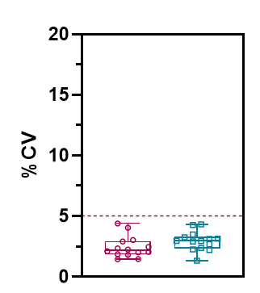
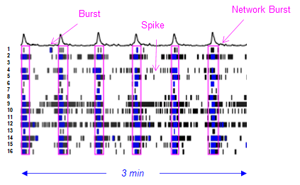

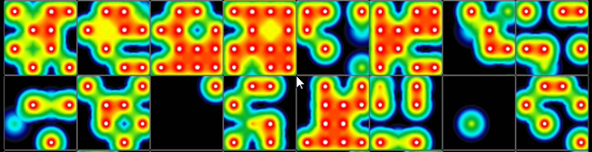
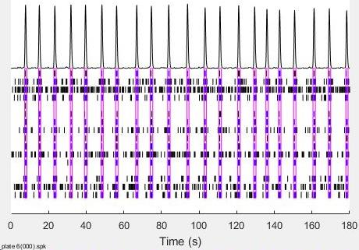
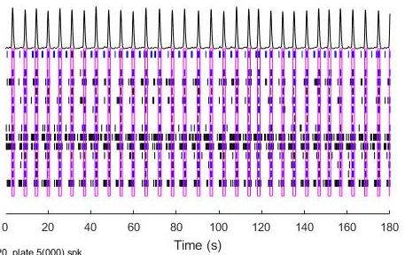
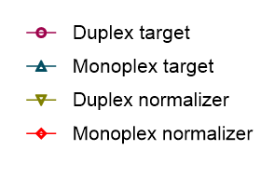
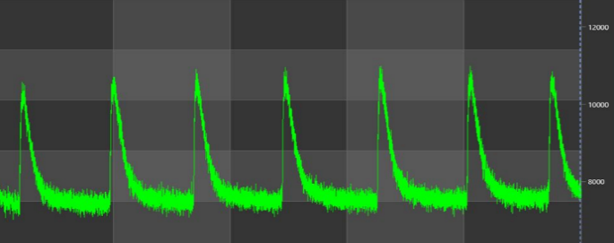
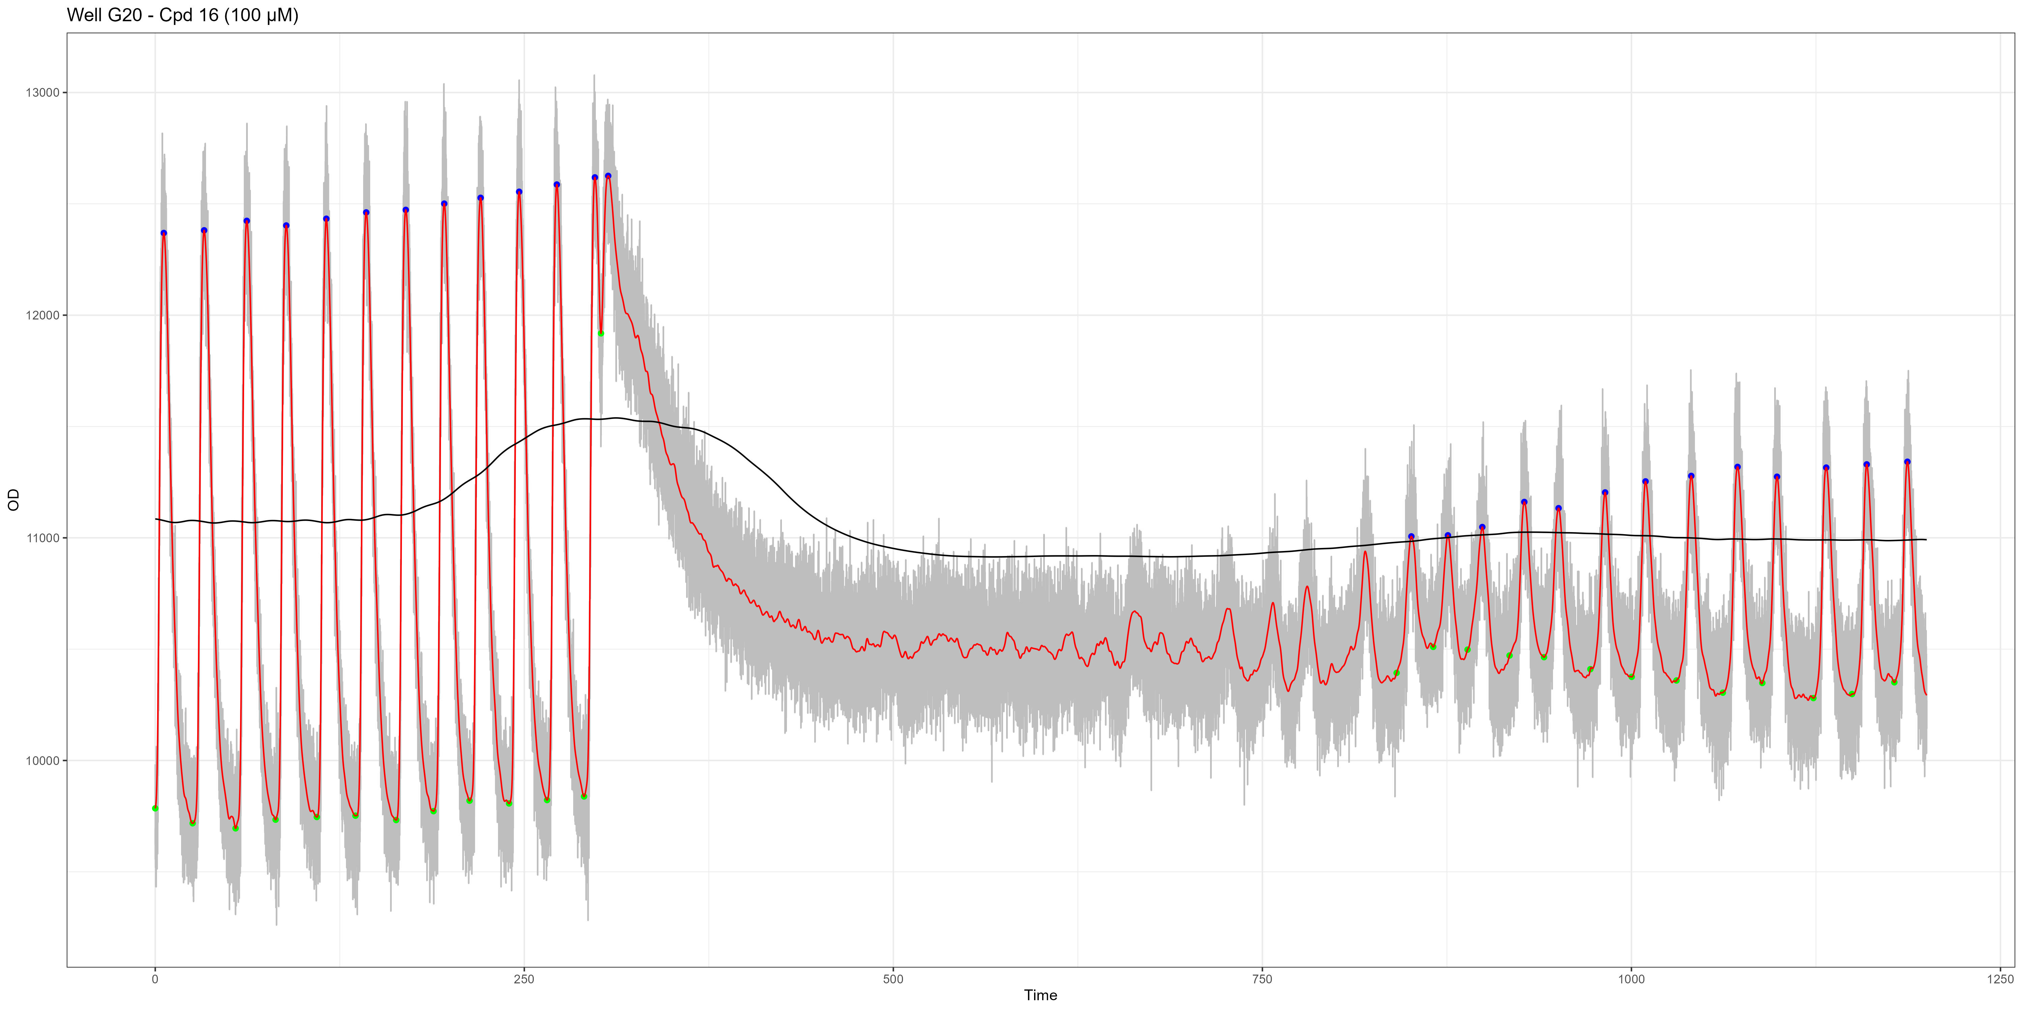
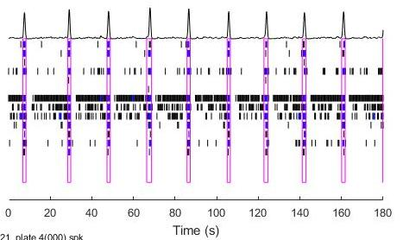
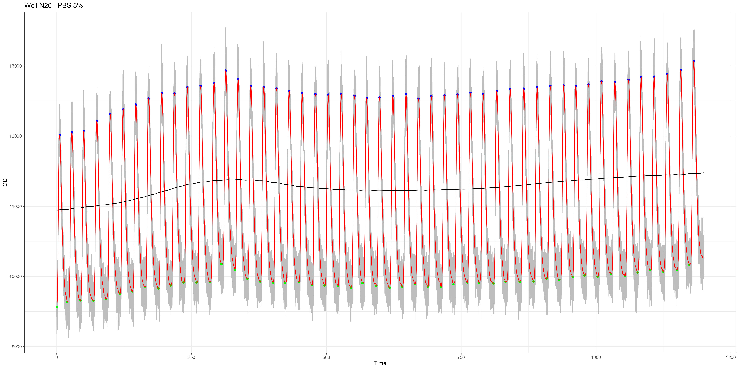
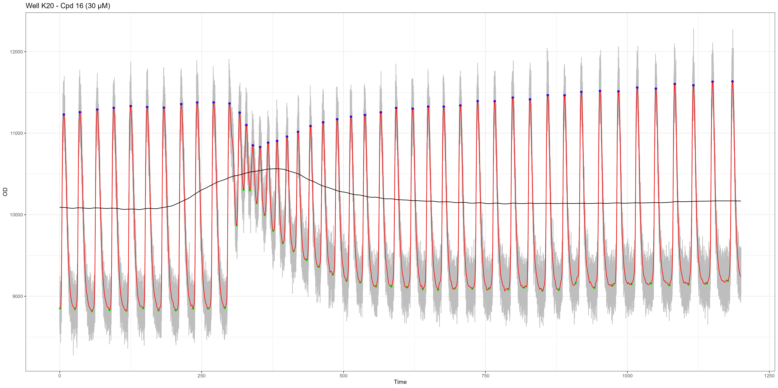
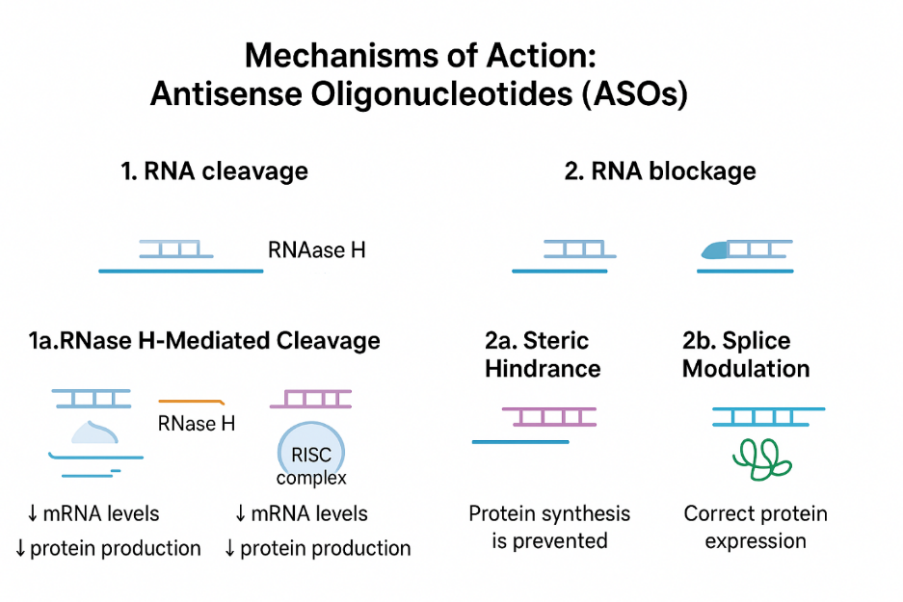
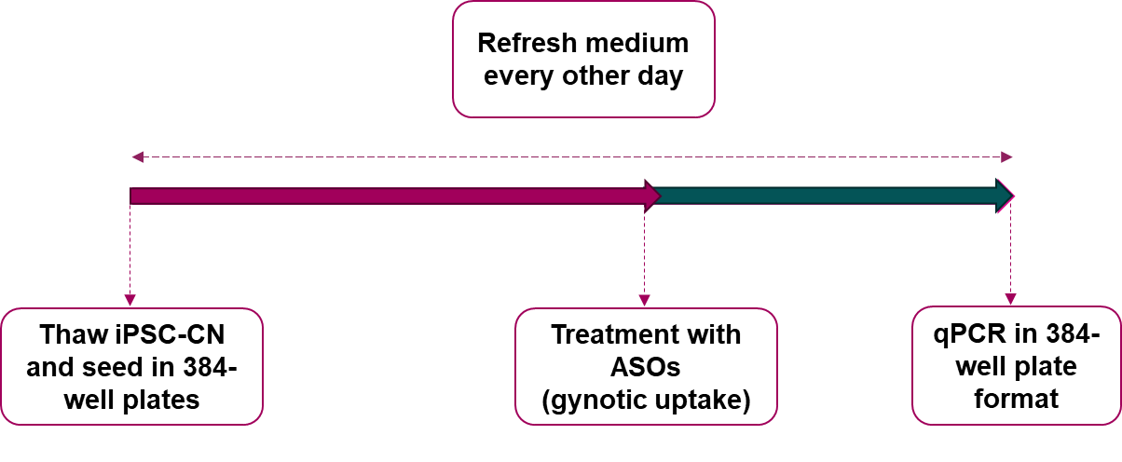
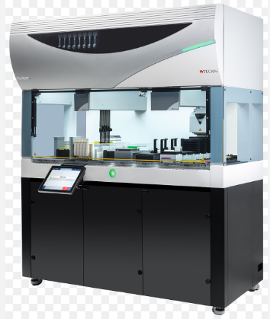
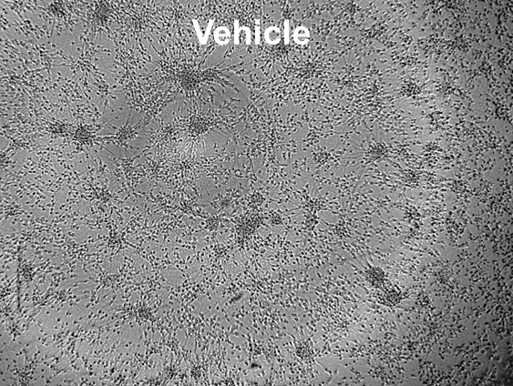
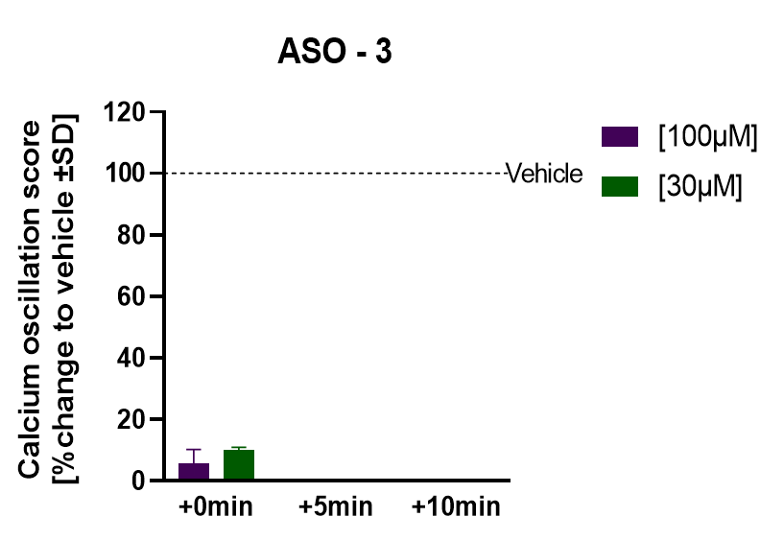
Development of a robust and scalable iPSC platform for predictions of efficacy and in vivo toxicity of RNA therapeutics early in the drug discovery pipeline
J.Koepke, B.Samson-Couterie, K.Pitsa, S.Jain;
Ncardia Services BV Leiden, The Netherlands, support@ncardia.com, www.ncardia.com
Background
RNA therapeutics, especially Antisense Oligonucleotides (ASOs), have huge potential to modify cellular pathways by inducing decay, steric blockage, or altered splicing of the target mRNA. These innovative molecules provide precise control over gene expression. Being able to predict acute side effects early in drug development facilitates the confident selection of candidates, saving both time and valuable resources.
Human induced pluripotent stem cells (hiPSCs) have become a powerful and versatile tool for drug discovery. They bring unprecedented opportunities for directly assessing human-specific toxicity and efficacy in physiologically relevant cell types, improving translational accuracy.
Ncardia developed two robust platforms using its hiPSC-derived neuronal cell models to screen both for efficacy and neurotoxicity of ASOs:
Cortical neurons (hiPSC-CNs) to study effects on target knockdown by RT-qPCR in a fully automated experimental setting including cell seeding, maintenance, ASO treatment, and RT-qPCR, which enabled the development of a highly reproducible and sensitive assay with both intra- and inter-plate variation (%CV) of <5%.
CNS cultures (hiPSC-CNS) to assess acute ASO neurotoxicity through quantification of intracellular calcium fluxes, providing an efficient and human-relevant approach for neurotoxicity screening in early discovery.
Automated platform for ASO screening
Automated platform for ASO screening
In vitro safety assessment of ASOs
A
Selection of multiple primers and probes against target
A
PC
NC
B
Dose response curves in biological duplicate plates of a test ASO
Selection of
Ncyte CNS on multi-electrode array (MEA)
Activity map
Raster plots of firing activity is organized
Vehicle
Illustrate representative outcomes from the MEA assay used to evaluate the effects of ASOs. This assay enables us to functionally assess neuronal activity and detect potential cytotoxic effects.
In vehicle treated wells, spikes and network bursts are strong and at regular intervals
In neuronal co-cultures treated with ASO-1, a significant decrease in amplitude with an increase in event frequency was observed, suggesting an overall excitatory or hyperactive neuronal profile.
ASO 2 demonstrates a “toxic” ASO, which causes marked disruptions in electrical activity such as reduced amplitude and network burst frequency, consistent with impaired neuronal excitability.
(A) shows the mean of negative control conditions across 14 cell plates. Each cell plate was run as technical PCR triplicate. In both cases, the inter-plate variability in positive or inter-plate variability between technical replicates was below 5% and the inter-plate variation among biological replicates was 2.8% for vehicle and 3.9% for the control, concluding a robust assay performance.
(B) shows an exemplary dose response of a test ASO in biological replicate. Data were plotted as %KD and fitted as non-linear, 4 parameter sigmoidal curve ± SD. Each line represents the fit of a technical PCR triplicate.
ASO 1
B
In vitro safety assessment of ASOs
Peak Rate
ASO 2
Amplitude
Peak to peak time
Prior to assay automation, two types of Real-Time qPCR assays were evaluated in a manual setup for a side-by-side comparison. We optimized the number of cells seeded per well in 384-well plate format, volume of lysis buffer as well as reverse transcriptase, cDNA dilution and PCR reaction volumes based on the PCR performance (linearity, amplification efficiency, curve fit, delta Ct) as illustrated in (A) in lysates from untreated cells. (B) shows the linear regression curves of the selected condition in monoplex and duplex PCR reactions per sample concentration (mean ± SD).
Maturation and staining with calcium dye
Addition of ASOs
Toxic ASO
Calcium Traces at Baseline
Non-toxic ASO
Collectively, these examples highlight how MEA can be applied as a sensitive, functional screen to discriminate between safe and neurotoxic ASOs.
Ncyte CNS composed of glutaminergic, cholinergic and GABAergic neurons and astrocytes
Quantification of calcium peak amplitude, peak to peak time and peak rate
Recording of spontaneous calcium peaks
Exemplar calcium traces from Ncyte CNS cultures treated with toxic (upper trace) and non-toxic ASOs (lower trace). Toxic ASOs cause the disruption of spontaneous calcium activity
A
Automated media refreshes and ASO addition
Conclusions
Fully automated RT-qPCR assay established to assess ASO efficacy in human iPSC-derived neurons, delivering highly robust data (<5% inter-plate variability) and applicable across multiple iPSC-derived cell types.
High-throughput calcium transient assay using Ca²⁺ imaging in hiPSC-derived CNS cultures to evaluate dose-dependent acute neurotoxicity of ASOs.
MEA (microelectrode array) assay developed to assess ASO-induced effects on neuronal network activity, capturing changes in firing rate, burst frequency, and synchrony.
These assays are available on-demand to support candidate prioritization before in vivo studies, reducing animal use and increasing confidence in translational success.
Graphs show illustrations demonstrating how the optimized calcium transient assay was applied to evaluate ASO-induced effects across a range of concentrations.
This sensitive assay enables clear differentiation between:
ASO 1 shows an example of a putative “safe” ASO, which does not alter calcium transient amplitude, frequency, or kinetics compared to untreated controls, indicating preserved neuronal function.
ASO 2 depicts an ASO that appears acutely safe at lower concentrations but begins to show changes in calcium signaling parameters as the concentration increases, suggesting a narrow safety window.
ASO 3 demonstrates a “toxic” ASO, which causes marked disruptions in calcium transient patterns such as reduced amplitude, irregular frequency, or complete loss of activity consistent with impaired neuronal viability or excitability.
Automated plate coating and cell seeding
Treatment with ASOs (gymotic) uptake
Automated RNA extraction, cDNA synthesis and qPCR
100 µm
100 µm
B
C
Adapted from J. Clin. Med. 2020, 9(6), 2020 10.3390/jcm9062004
Designed to bind complementary RNA targets, ASOs can modulate RNA processing to reduce, restore, or modify protein expression through several distinct mechanisms. These include promoting RNA degradation via RNase H, altering splicing patterns, or blocking translation, thereby enabling precise and targeted regulation of gene expression at the RNA level.
(A) illustrates the assay setup from cell seeding until downstream assay. All steps were performed using a cell culture grade fully automated liquid handling system as shown in (B). No significant morphological changes were visualized in vehicle controls as illustrated by phase contrast imaging (C). Neurons can be maintained in culture for extended periods.
Ncardia developed a neuronal and tri-culture model for Alzheimer’s Disease suitable for screening of therapeutics
Ncardia’s hiPSC-derived neuronal cell models enable early screening for ASO efficacy and neurotoxicity, providing a powerful platform for improving drug development efficiency.
Contact us at support@ncardia.com or scan the QR code to download the poster
Notes:
Figure 2: Maturation of iPSC-derived Neuronal Mix
Plate ID on SiMA: R3030-03->EXP03-P02-B4-wk5-40x_22354
Folder in Box: https://ncardia.app.box.com/folder/271386571039
Wells/fields (condition)
AraC + GENtoniK 0,3 µM- well I7 field 3
AraC/DAPT + GENtoniK 0,1 µM- well K10 field 1
Channels
FITC- PSD-95
Texas Red- synaptophysin
Cy5- MAP2
Figure 3: Tri culture composition (neurons, astrocytes and microglia)
Plate ID on SiMA: R3030-04->EXP08-PL01-MS2_22438
Folder in Box: https://ncardia.app.box.com/folder/279079347835
Wells/fields (condition)
Transduced/vehicle – well N8 field 3
dGAE 2,5 µg/mL- well N9 field 3 [Conc 1]
dGAE 5 µg/mL- well N10 field 3 [Conc 2]
K18 0,75 µg/mL-well N11 field 3 [Conc 1]
K18 1,5 µg/mL- well N12 field 3 [Conc 2]
LPS 500 ng/mL- well N14 field 3
Channels
FITC- IBA1
Texas Red- MAP2
Cy5- GFAP
Figure 4: Tri culture day 30 (pTau/MC1/Tau)
Plate ID on SiMA: R3030-04->EXP08-PL01-MS1_22437
Folder in Box: https://ncardia.app.box.com/folder/279078426775
Wells/fields (condition)
Transduced/vehicle - well K6 field 4
dGAE 2,5 µg/mL- well H10 field 3
K18 1,5 µg/mL- well H11 field 5
Channels
FITC-MC1
Texas Red-pTau
Cy5-Tau

