Slide 1
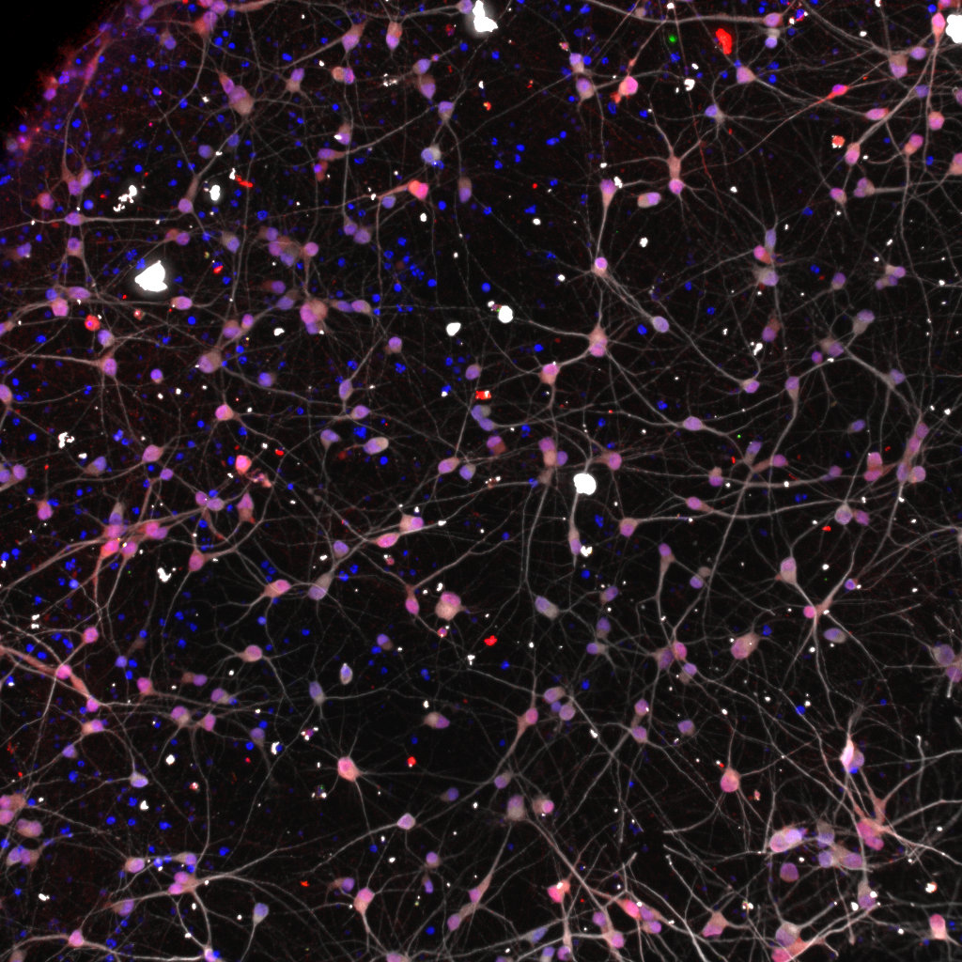
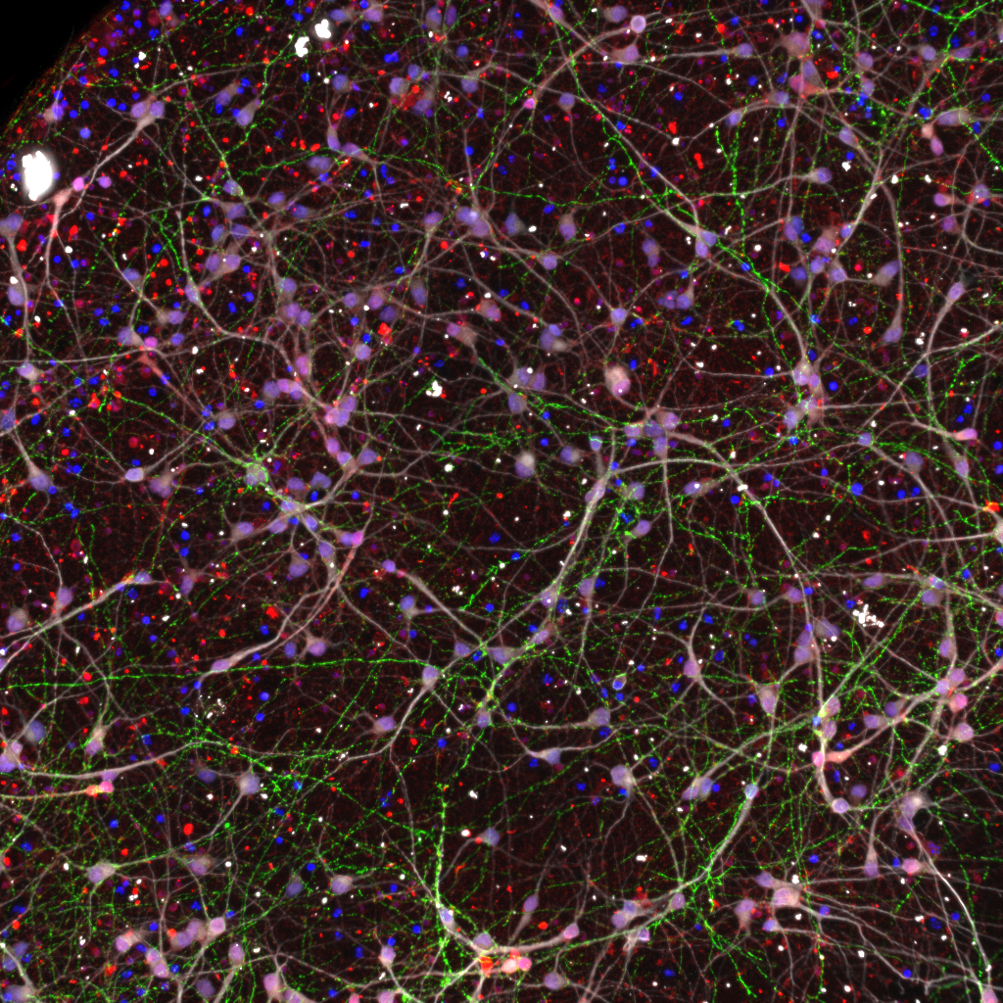
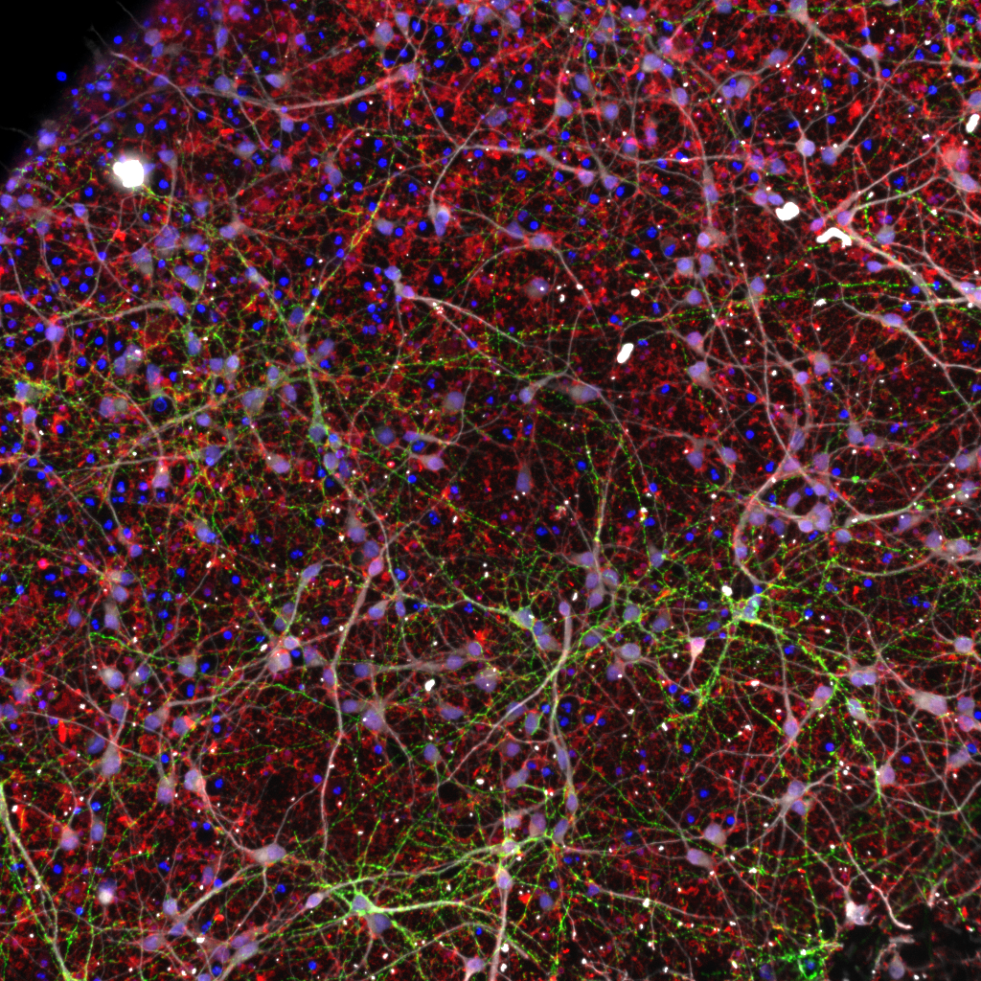
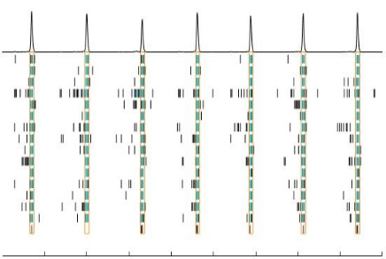
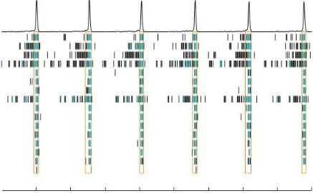
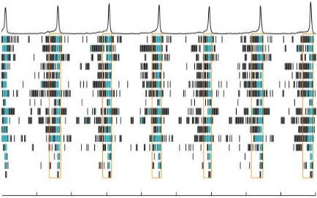
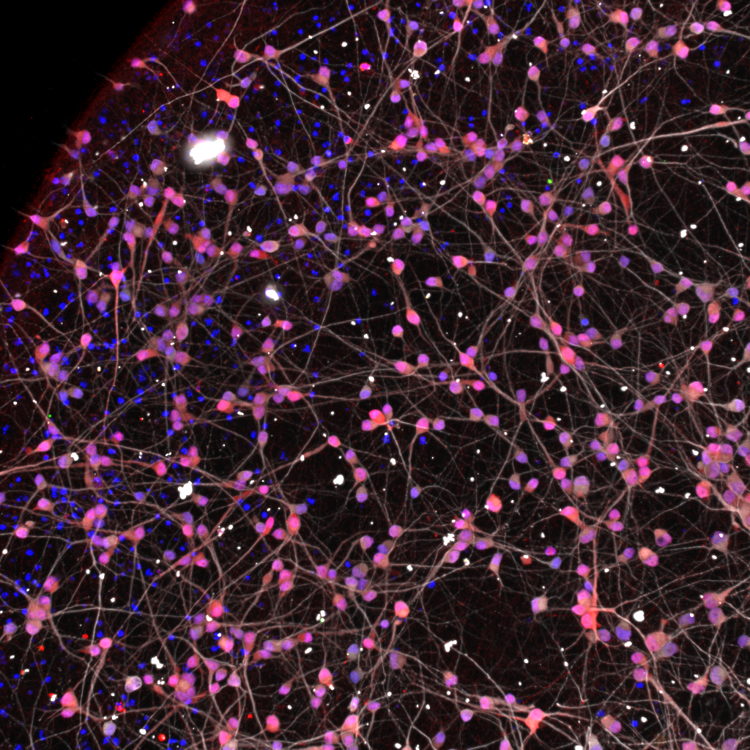
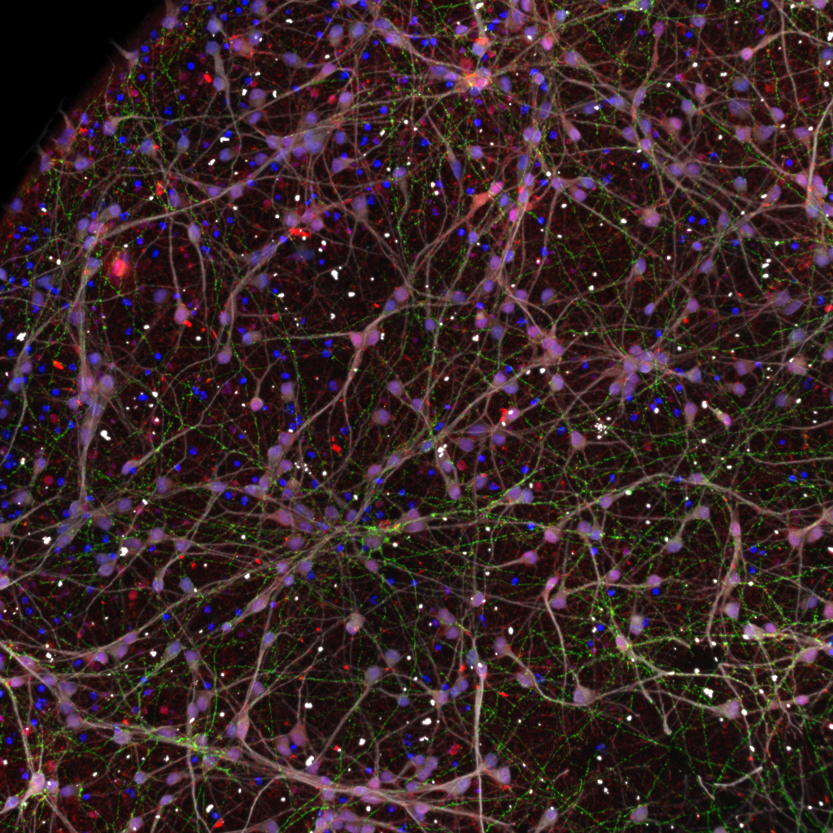
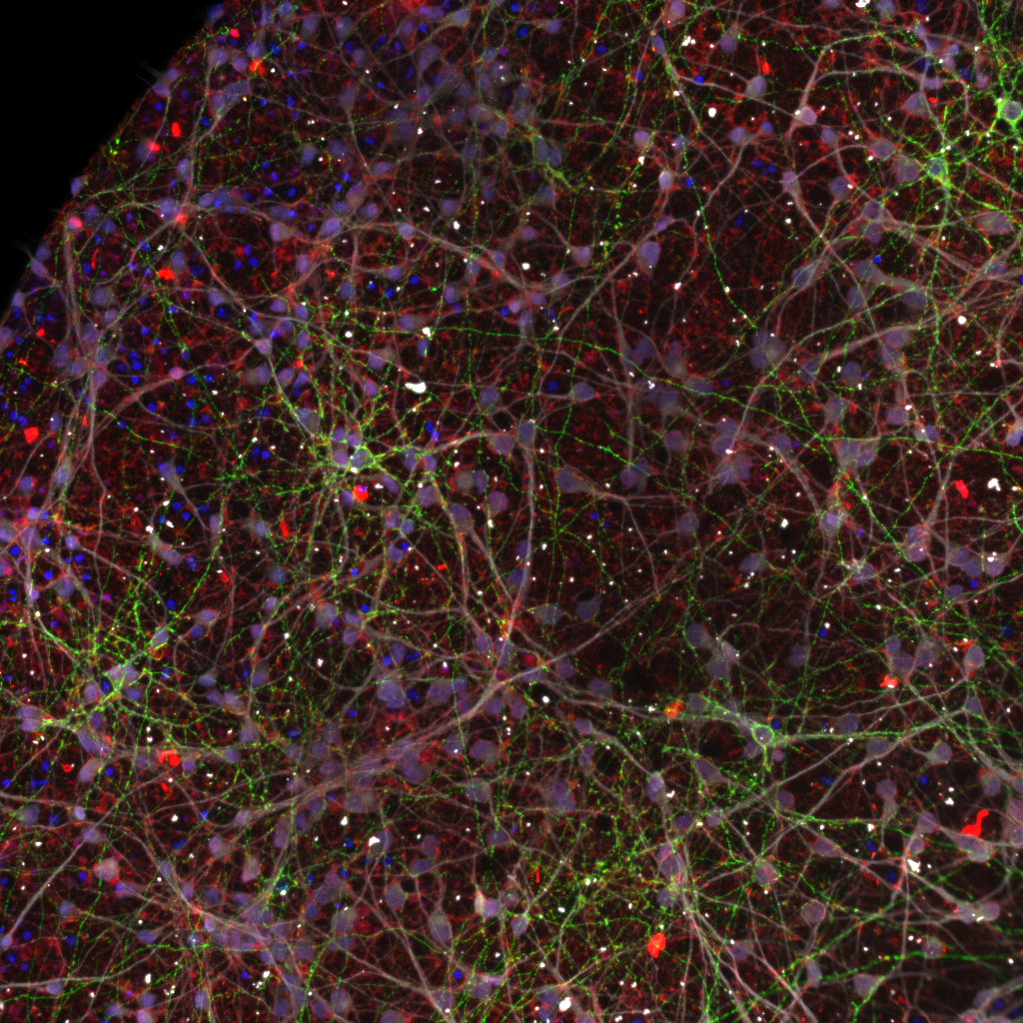
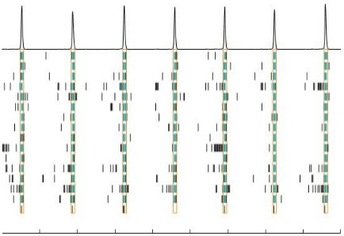
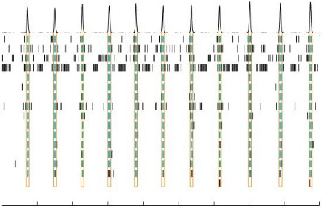
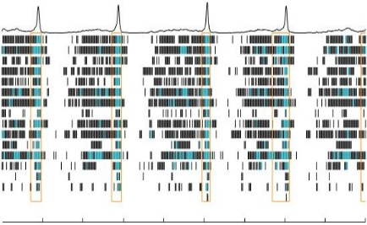
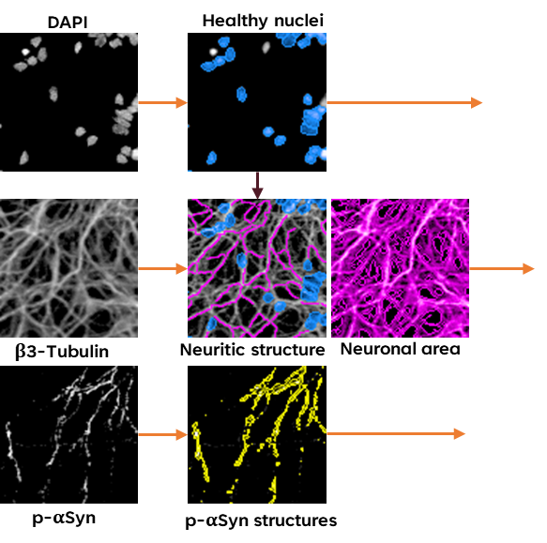
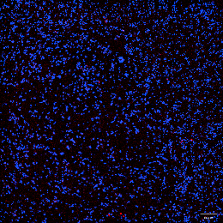
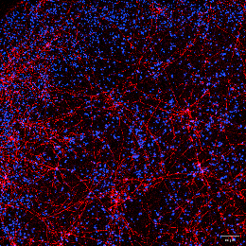
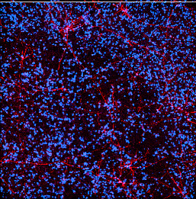
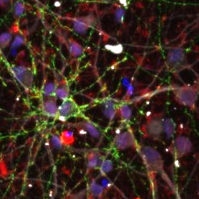
Development of iPSC-based Parkinson’s disease model for drug discovery
K. Pitsa, L. Smit, C. Van Berkel, B. Samson-Couterie, S. Jain
Ncardia Services BV Leiden, The Netherlands, support@ncardia.com, www.ncardia.com
Background
Parkinson’s disease (PD) is the second most common neurodegenerative disorder, with a prevalence that has more than doubled over the past decades and is expected to double again in the coming years. Despite extensive research, the precise causes of PD remain incompletely understood, and a definitive, disease-modifying treatment is still lacking. One of the key challenges lies in the use of suboptimal preclinical models, which fail to accurately reproduce the wide range of pathological phenotypes observed in PD patients.
Induced pluripotent stem cells (iPSCs), particularly patient-specific iPSCs, represent a powerful and physiologically relevant system to overcome many of these limitations.
At Ncardia, iPSC-derived dopaminergic neurons (iPSC-DNs) were treated with α-synuclein (SNCA) recombinant pre-formed fibrils (PFFs) to model disease-relevant PD phenotypes. Using high-content imaging, several quantitative readouts were analyzed, including phosphorylated alpha-synuclein (pS129 α-Syn) area, number of puncta, and intensity. Furthermore, Ncardia investigated the impact of α-Syn accumulation on autophagy dynamics, mitochondrial density and functionality, as well as proteasomal activity and neuronal network activity using microelectrode array (MEA) recordings.
Treatment of iPSC-DNs with PFFs resulted in a strong and reproducible increase in phosphorylated α-Syn, accompanied by disrupted autophagy, reduced mitochondrial density and function, and significantly decreased proteasomal activity. Together, these findings provide a comprehensive in vitro model that recapitulates key hallmarks of PD pathology and enables the assessment of potential therapeutic interventions.
1. Induction of phospho-SNCA pathology
3. Mitochondria staining with phospho-SNCA pathology
5. Electrophysiology assessment of dopaminergic neurons
A
UTC
PFF Conc. 1
PFF Conc. 2
A
WT UTC
WT PFF Conc. 1
WT PFF Conc. 2
0.1% DMSO
10 µM SKF 83822
10 µM Sumanirole
WT
Baseline
Hoechst / Tom20
GBA Mutant PFF Conc. 1
GBA Mutant UTC
GBA Mutant PFF Conc. 2
GBA Mutant
30 min
B
DAPI / αSyn / p-αSyn / MAP2
B
Multi-parametric High Content analysis
Identification of neurons
Quantify cell/neurite morphology (area, length etc.) for assessment of neuronal health
Quantify area, intensity and size p-α Synuclein puncta within neurites
Representative images of healthy (WT) and GBA N370S mutant DN treated with two concentrations of PFF stained with MitoTracker and Hoechst (nuclei)
B) Quantification of MitoTracker positive area and intensity. Mean ± SD. Significance to respective UTC control. * p. < 0.05; ** p. < 0.01;
*** p. < 0.001; **** p. < 0.0001
C
Treatment of dopaminergic neurons with a-Syn PFF leads to a clear induction of phosphorylated a-Synuclein which can be reversed by rapamycin
Electrophysiology of WT dopaminergic neurons on MEA
Quantification of main MEA metrics in healthy (WT) and in response to D1 and D2 receptor agonists. D1 receptor agonist (SKF 83822): increased firing, bursting and number of network bursts. D2 receptor agonist (Sumanirole): loss of higher level of firing activity
Treatment of dopaminergic neurons with a-Syn PFFs leads to a reduction of mitochondria density
MEA assay shows a robust activity suitable compound screening and neurotoxicity assessment
D
4. Proteosome activity in dopaminergic with phospho-SNCA pathology
Conclusions
Ncardia developed a comprehensive suite of assays designed to recapitulate the key pathological hallmarks of PD using human iPSC-derived neuronal cell models. These advanced in vitro systems provide clinically relevant and translational readouts that enable drug innovators to evaluate compound efficacy and safety at multiple stages of the drug discovery process. By leveraging human-based cellular models, Ncardia helps increase confidence in preclinical predictions, bridge the gap between in vitro and in vivo outcomes, and potentially reduce reliance on animal testing.
A
Medium refresh
Day 21/28
Data analysis
Day 21/28
Vehicle
PFFs alone
5 µM Rapamycin
α-Syn PFFs
phospho-αSyn/DAPI
Extracellular
Seed dopaminergic neurons*
Treat with assay controls or test compounds
Proteasome assay
High-content based image analysis using Ncardia’s in-house developed algorithms
p-αSyn
Intracellular
Propagation
Live staining
Pathologic α-Syn
Proteasome activity
Electrophysiological deficits?
Treat cells with PFF to generate disease model
ICC / Confocal imaging
Proteasome assay and MEA data analysis
phospho-αSyn/μm2
[%change to trigger]
Mitochondria
density
MEA
log [M] Rapamycin
Proteosome activity assay
Quantification of Proteosome activity in WT and GBA mutant dopaminergic neurons treated with two concentrations of PFF or MG132 (Assay Ctrl), normalized on nuclei count. Mean ± SD. Significance to respective UTC.
* p. < 0.05; **** p. < 0.0001
Representative ICC images of healthy (WT) and GBA N370S mutant DN treated with two concentrations of PFF. Staining for nuclei (DAPI), DN (MAP2), α-Synuclein (αSyn) and phospho αSynuclein (p-αSyn)
High content quantification of neuronal health, neurite network and phospho-SNCA area and intensity
Quantification of p-αSyn Puncta in WT and GBA mutant DN treated with two concentrations of PFF. Mean ± SD. Significance to respective untreated control (UTC) control. **** p. < 0.0001
Chronic treatment of SNCA PFF treated dopaminergic neurons with rapamycin, led to a significant decrease in phospho-SNCA levels. **** p. < 0.0001
Schematic of the PD model using iPSCs derived neurons, astrocytes treated with SNCA PFFs.
* iCell® DopaNeurons 01279 (WT) and GBA N370S 11344 (GBA Mutant) from FUJIFILM Cellular Dynamics, Inc.
Treatment of dopaminergic neurons with a-Syn PFF leads to a 50-40% reduction in proteasome activity
Contact us at
support@ncardia.com
or scan the QR code
to download the poster
Parkinson's disease lacks a definitive treatment, but patient-specific iPSC-derived models offer a promising solution to better replicate disease phenotypes and advance drug discovery efforts.
Advancing Parkinson’s research with human-relevant iPSC models that enhance predictability and reduce animal testing.
Contact us at support@ncardia.com or scan the QR code to download the poster

